Slide 1
Java
Exception Handling

Slide 2
Exception-Handling Fundamentals
Exception: an abnormal condition that arises in a code sequence at run time/ run time error
Java exception is an object that describes an exceptional (that is, error) condition
When an exceptional condition arises, an object representing that exception is created and thrown in the method that caused the error
Exception can be
generated by the Java run-time system (relate to fundamental errors that violate the rules of the Java language)
Manually generated (typically used to report some error condition to the caller of a method)

Slide 3
Keywords for exception handling
try block contains program statements that are to be to monitored for exceptions
If an exception occurs within the try block, it is thrown
catch block contain statements that catch this exception and handle it in some rational manner
System-generated exceptions are automatically thrown by the Java runtime system.
throw is used to manually throw an exception
throws clause is used to specify any exception that is thrown out of a method
finally block contains code that absolutely must be executed after a try block completes

Slide 4
General form of an exception-handling block
try {
// block of code to monitor for errors
}
catch (ExceptionType1 exOb) {
// exception handler for ExceptionType1
}
catch (ExceptionType2 exOb) {
// exception handler for ExceptionType2
}
// ...
finally {
// block of code to be executed after try block ends
}

Slide 5
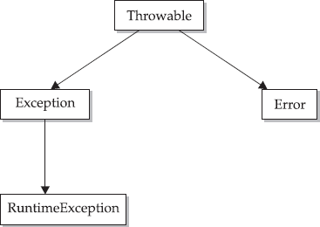
Exception Types
All exception types are subclasses of the built-in class Throwable
Below Throwable are two subclasses that partition exceptions into two branches
Exception class: used for exceptional conditions that user programs should catch
RuntimeException etc are
subclasses of Exception
Error class: used by the Java run- time system to indicate errors having to do with the run-time environment (eg Stack overflow)

Slide 6
Uncaught Exceptions
Uncaught exception :caught by the default handler (provided by the Java run-time system) that
displays a string describing the exception
prints a stack trace from the point at which the exception occurred
terminates the program
java.lang.ArithmeticException: / by zero at Exc0.main(Exc0.java:4)

Slide 7
Using try and catch
Exception handling benefits
allows you to fix the error
prevents the program from automatically terminating
class Exc2 {
public static void main(String args[]) {
int d, a;
try { // monitor a block of code. d = 0;
a = 42 / d;
System.out.println("This will not be printed.");
} catch (ArithmeticException e) {
// catch divide-by-zero error
System.out.println("Division by zero.");
}
System.out.println("After catch statement.");
}
}

Slide 8
Using try and catch
class Exc2 {
public static void main(String args[]) { int d, a;
try { // monitor a block of code.
d = 0;
a = 42 / d;
System.out.println("This will not be printed.");
} catch (ArithmeticException e) {
// catch divide-by-zero error
System.out.println("Division by zero.");
}
System.out.println("After catch statement.");
}
OUTPUT
Division by zero.
After catch statement.
}

Slide 9
Another Example
// Handle an exception and move on. import java.util.Random;
class HandleError {
public static void main(String args[]) { int a=0, b=0, c=0;
Random r = new Random(); for(int i=0; i<32000; i++) { try {
b = r.nextInt(); c = r.nextInt(); a = 12345 / (b/c);
} catch (ArithmeticException e) { System.out.println("Division by zero."); a = 0; // set a to zero and continue
}
System.out.println("a: " + a);
}
}
}

Slide 10
Displaying a Description of an Exception
Throwable overrides the toString( ) method (defined by Object) so that it returns a string containing a description of the exception
catch (ArithmeticException e) {
System.out.println("Exception: " + e);
a = 0; // set a to zero and continue
}
OUTPUT
Exception: java.lang.ArithmeticException: / by zero

Slide 11
Multiple catch Clauses
Use when more than one exception could be raised by a single piece of code
When an exception is thrown, each catch statement is inspected in order, and the first one whose type matches that of the exception is executed
All others are bypassed
execution continues after the try / catch block
NOTE: exception subclasses must come before any of their superclasses because a catch statement that uses a superclass will catch exceptions of that type plus any of its subclasses

Slide 12
Multiple catch Clauses (Example)
class MultipleCatches {
public static void main(String args[]) {
try {
int a = args.length; System.out.println("a = " + a); int b = 42 / a;
int c[] = { 1 };
c[42] = 99;
} catch(ArithmeticException e) { System.out.println("Divide by 0: " + e);
} catch(ArrayIndexOutOfBoundsException e) {
System.out.println("Array index oob: " + e);
}
System.out.println("After try/catch blocks.");
}
}

Slide 13
Multiple catch Clauses (Example)
OUTPUT
C:\>java MultipleCatches a = 0
Divide by 0: java.lang.ArithmeticException: / by zero After try/catch blocks.
C:\>java MultipleCatches TestArg a = 1
Array index oob: java.lang.ArrayIndexOutOfBoundsException:42 After try/catch blocks.

Slide 14
Nested try Statements
a try statement can be inside the block of another try
Each time a try statement is entered, the context of that exception is pushed on the stack
If an inner try statement does not have a catch handler for a particular exception, the stack is unwound and the next try statement’s catch handlers are inspected for a match
This continues until one of the catch statements succeeds, or until all of the nested try statements are exhausted
If no catch statement matches, then the Java run-time system will handle the exception

Slide 15
Nested try Statements (Example)
class NestTry {
public static void main(String args[]) { try {
int a = args.length;
int b = 42 / a; System.out.println("a = " + a); try { // nested try block
if(a==1) a = a/(a-a); // one command-line arg, division by zero if(a==2) {
int c[] = { 1 };
c[42] = 99; // two command-line args, out-of-bounds exception
}
} catch(ArrayIndexOutOfBoundsException e) {
System.out.println("Array index out-of-bounds: " + e);
}
} catch(ArithmeticException e) {
System.out.println("Divide by 0: " + e);
}
}
}

Slide 16
Nested try Statements (Example)
OUTPUT
C:\>java NestTry
Divide by 0: java.lang.ArithmeticException: / by zero C:\>java NestTry One
a = 1
Divide by 0: java.lang.ArithmeticException: / by zero C:\>java NestTry One Two
a = 2
Array index out-of-bounds: java.lang.ArrayIndexOutOfBoundsException:42

Slide 17
throw
To throw an exception explicitly, use the throw
statement
flow of execution stops immediately after the throw
statement
nearest enclosing try block is inspected to see if it has a catch statement that matches the type of exception and control is transferred to that statement
No match: next enclosing try statement is inspected, and so on
no matching catch found in any block: default exception handler halts the program and prints the stack trace

Slide 18
throw (example)
class ThrowDemo {
static void demoproc() {
try {
throw new NullPointerException("demo");
} catch(NullPointerException e) { System.out.println("Caught inside demoproc."); throw e; // rethrow the exception
}
}
public static void main(String args[]) {
try {
demoproc();
} catch(NullPointerException e) { System.out.println("Recaught: " + e);
}
}
}

Slide 19
throw (example)
class ThrowDemo {
static void demoproc() {
try {
throw new NullPointerException("demo");
} catch(NullPointerException e) { System.out.println("Caught inside demoproc."); throw e; // rethrow the exception
}
}
public static void main(String args[]) {
try {
demoproc();
} catch(NullPointerException e) {
System.out.println("Recaught: " + e);
}
}
OUTPUT
Caught inside demoproc.
Recaught: java.lang.NullPointerException: demo
}

Slide 20
throws
If method can cause an exception that it does not handle
Then method’s declaration must include a throws clause (that lists the types of exceptions that a method might throw)
Necessary for all exceptions, except Error or
RuntimeException, or any of their subclasses

Slide 21
throws (example)
class ThrowsDemo {
static void throwOne() throws IllegalAccessException
{
System.out.println("Inside throwOne.");
throw new IllegalAccessException("demo");
}
public static void main(String args[]) { try {
throwOne();
} catch (IllegalAccessException e) {
System.out.println("Caught " + e);
}
}
}

Slide 22
throws (example)
class ThrowsDemo {
static void throwOne() throws IllegalAccessException
{
System.out.println("Inside throwOne.");
throw new IllegalAccessException("demo");
}
public static void main(String args[]) { try {
throwOne();
} catch (IllegalAccessException e) {
System.out.println("Caught " + e);
}
}
}
OUTPUT
inside throwOne
caught java.lang.IllegalAccessException: demo

Slide 23
finally
finally creates a block of code that will be executed after a try /catch block has completed and before the code following the try/catch block
finally block will execute whether or not an exception is thrown
If an exception is thrown, the finally block will execute even if no catch statement matches the exception
useful for closing file handles and freeing up any other resources
finally clause is optional

Slide 24
finally (example)
class FinallyDemo {
static void procA() {
try {
System.out.println("inside procA"); throw new RuntimeException("demo");
} finally { System.out.println("procA's finally");}
}
static void procB() { try {
System.out.println("inside procB"); return;
} finally { System.out.println("procB's finally"); }
}
static void procC() {
try {
System.out.println("inside procC");
} finally { System.out.println("procC's finally"); }
}
public static void main(String args[]) {
try {
procA();
} catch (Exception e) { System.out.println("Exception caught");
}
procB();
procC();
}
}

Slide 25
finally (example)
class FinallyDemo {
static void procA() {
try {
System.out.println("inside procA"); throw new RuntimeException("demo");
} finally { System.out.println("procA's finally");}
}
static void procB() { try {
System.out.println("inside procB"); return;
} finally { System.out.println("procB's finally"); }
}
static void procC() {
try {
System.out.println("inside procC");
} finally { System.out.println("procC's finally"); }
OUTPUT
inside procA procA's finally Exception caught inside procB procB's finally inside procC procC's finally
}
public static void main(String args[]) {
try {
procA();
} catch (Exception e) { System.out.println("Exception caught");
}
procB();
procC();
}
}

Slide 26
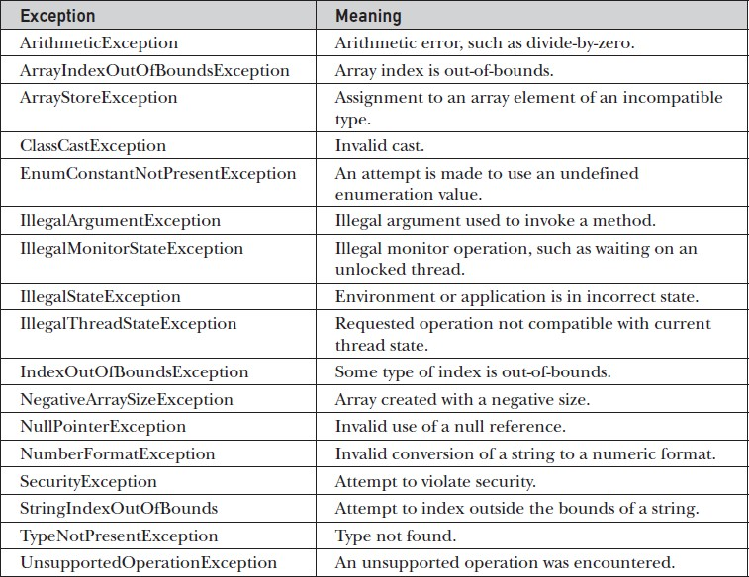
Java’s Built-in Exceptions
Java’s Unchecked RuntimeException Subclasses Defined in java.lang

Slide 27
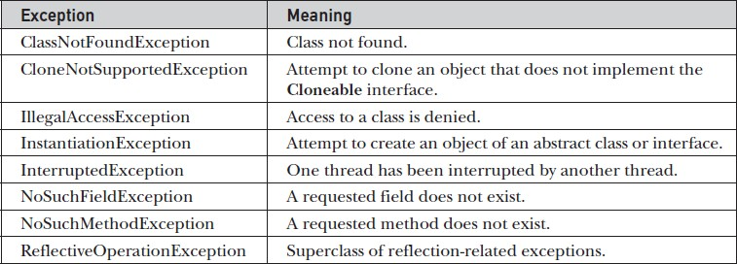
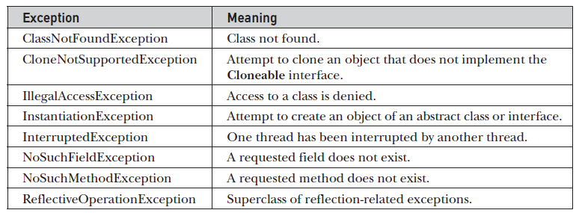
Java’s Built-in Exceptions
Java’s Checked Exceptions Defined in java.lang

